Slide 1
Deep Convolutional Variational Autoencoder for Anomalous Sound Detection
Group3 王映勻 王盈驊 謝銘峰

Slide 2
Outline
Introduction
System model
CVAE (As the reference paper)
Normal Convolutional VAE
Data Preprocessing
Results & Discussion
Conclusion
Reference

Slide 3
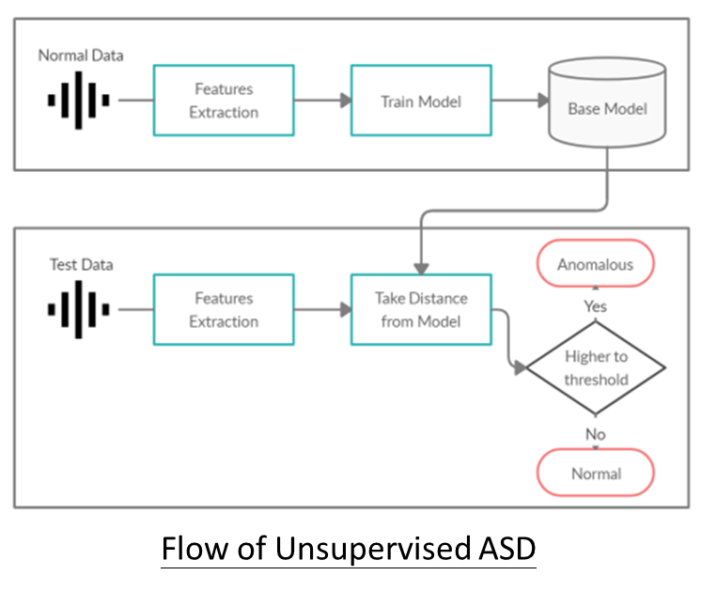
Introduction
The contribution of the reference paper is designing a special model of CVAE, which is a combination of CAE and VAE, to solve the ASD (Anomalous Sound Detection) problem.
In this project, we propose applying a network of normal convolutional VAE, and compare with the result of the CVAE model of the reference paper.

Slide 4
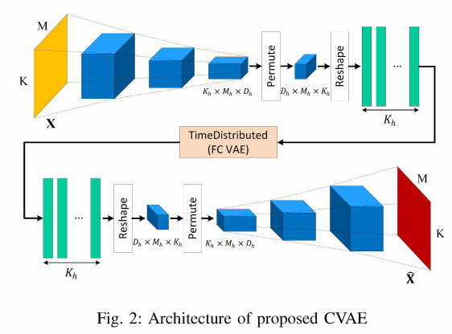
System model - CVAE (As the reference paper)
Layer
Conv2D(32)
Conv2D(32)
Conv2D(32)
Conv2D(1)
FC VAE
Conv2DTransposed(1)
Conv2DTransposed(32)
Conv2DTransposed(32)
Conv2DTransposed(32)
FC VAE
FC(32)
FC(16)
Two Gaussian approximations
FC(16)
FC(32)
FC(64)

Slide 5
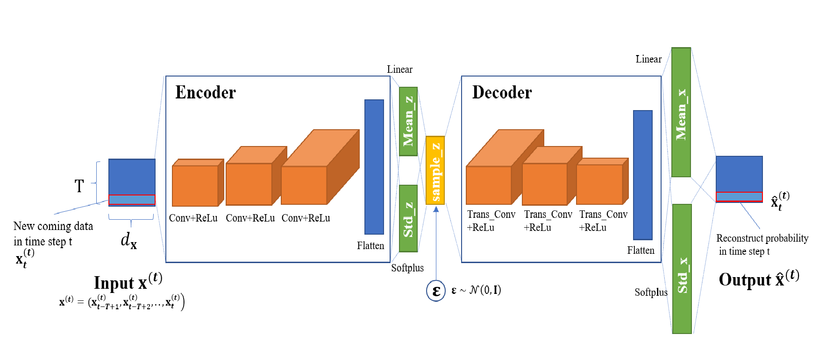
System model - Normal Convolutional VAE
Layer
Conv2D(32)
Conv2D(32)
Conv2D(32)
Two Gaussian approximations
Conv2DTransposed(32)
Conv2DTransposed(32)
Conv2DTransposed(32)

Slide 6
Data Preprocessing
Dataset - MIMII
This dataset comprises normal and anomalous sound segments from four industrial machine.
Types: fan, pump, slider and valve.
(Each type include ID 00, ID 02, ID 04 and ID 06)
Testing set: Composed of all anomalous segments and the same number of normal segments.
Training set: The rest of normal segments.
Notes:
10秒

Slide 7
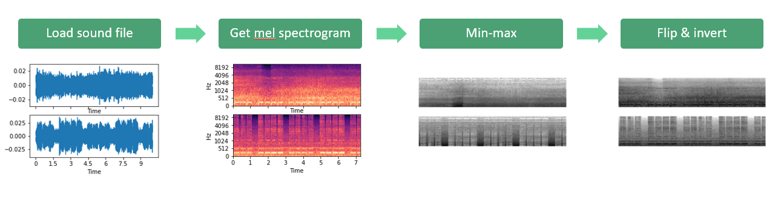
Data Preprocessing
Normal
Abnormal
Notes:
1. Use librosa to load sound file 2. Get mel spectrogram. (時間振幅-頻譜圖) 3. Do min-max (強調 edge) 4. Put low frequency at bottom and invert to match higher energy with black pixels.
Reshape the image to the size of 64*64

Slide 8
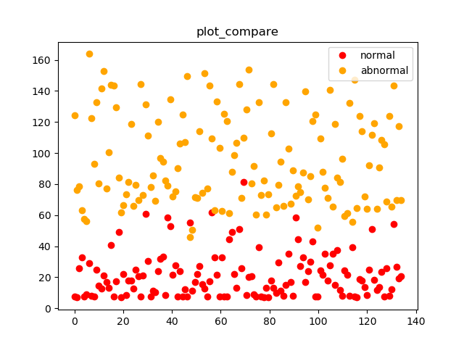
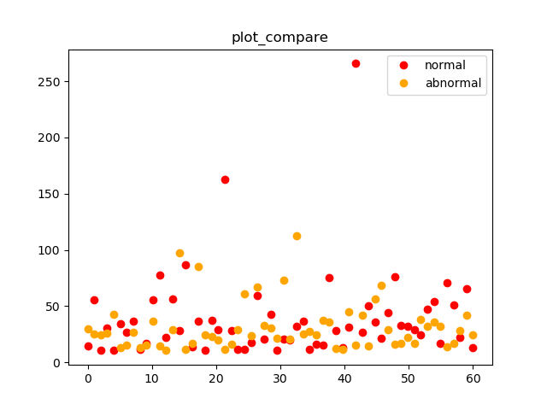
Results & Discussion
Input normal&abnormal sound file, and compare there reconstruction loss

Slide 9
Results & Discussion
Whether the model can classify normal & abnormal data(TPR > 80%)
 | CVAE (As the reference paper) |  |  |  | Normal Convolutional VAE
 | ID_00 | ID_02 | ID_04 | ID_06 | ID_00 | ID_02 | ID_04 | ID_06
Pump | Yes | No | Yes | No | Yes | No | Yes | No
Valve | No | No | No | No | No | No | No | No
Fan | No | Yes | Yes | Yes | No | No | Yes | Yes
Slider | Yes | Yes | No | No | Yes | Yes | No | No

Slide 10
Conclusion
CVAE in the reference paper is slighty better than Normal CVAE.
Data preprocessing is important for sound detection problem.
Same model training in same machine with different ID has different result.

Slide 11
Reference
https://ieeexplore-ieee-org.ezproxy.lib.nctu.edu.tw/abstract/document/9352085
https://ieeexplore-ieee-org.ezproxy.lib.nctu.edu.tw/document/9023488

Slide 12
Q&A

